Slide 1
2021/05/05 GFP Cooling System Test Update
Jiancheng Zeng
Northeastern University

Slide 2
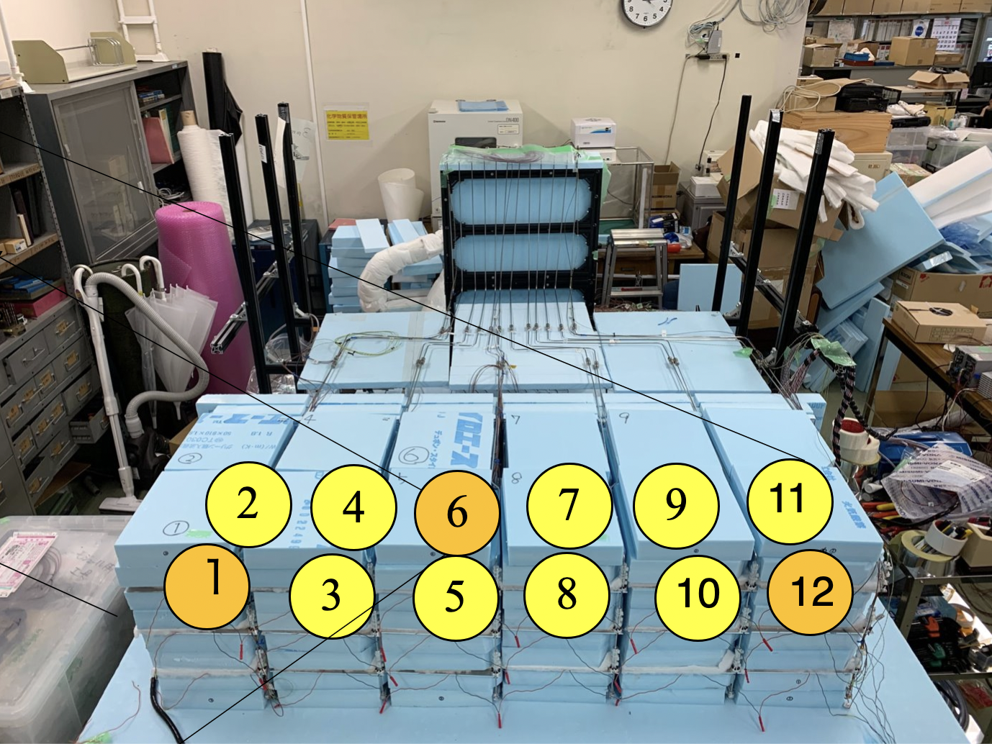

Slide 3
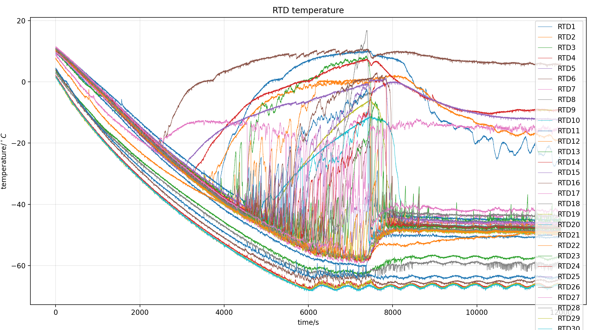
First testing general results
In general it takes 2 hours to let radiator and reservoir cool down to -70 degree C.
Here I didn’t include the warmup process, with chiller circulation pump working, it takes 3-4 hrs to come back to room temperature. With natural process it takes over 24 hrs to get back to room temperature
Chiller temperature is set to be -70 degree C, radiator temperatures are around -65 degree C

Slide 4
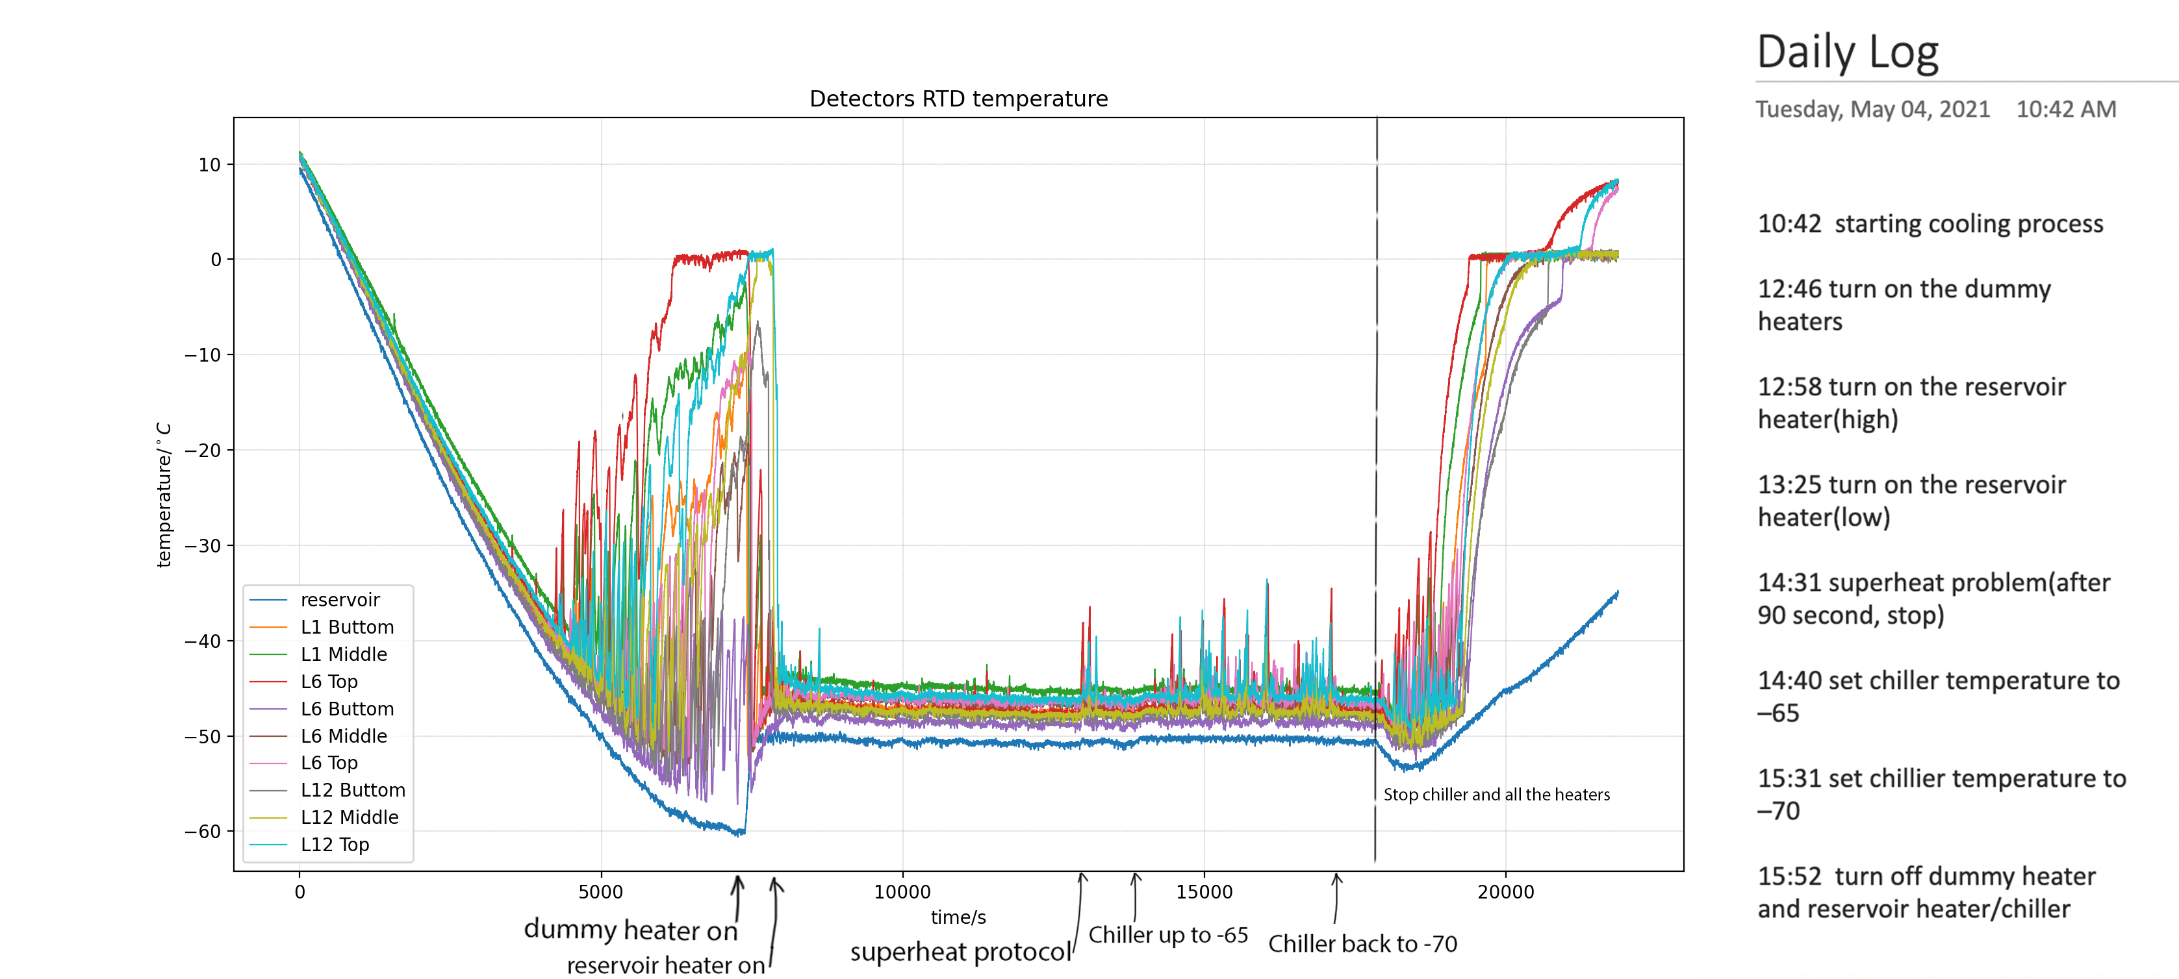
Detector temperature
After turn on dummy heaters and reservoir heater[-50.5, -50], temperature for each detector position drop dramatically, since the OHP circulation begin and heat will start transfer. The fluctuation for the equilibrium is about 1 degree C(see next slide).

Slide 5
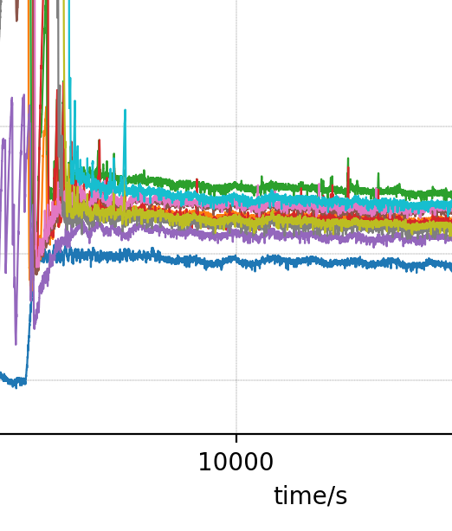
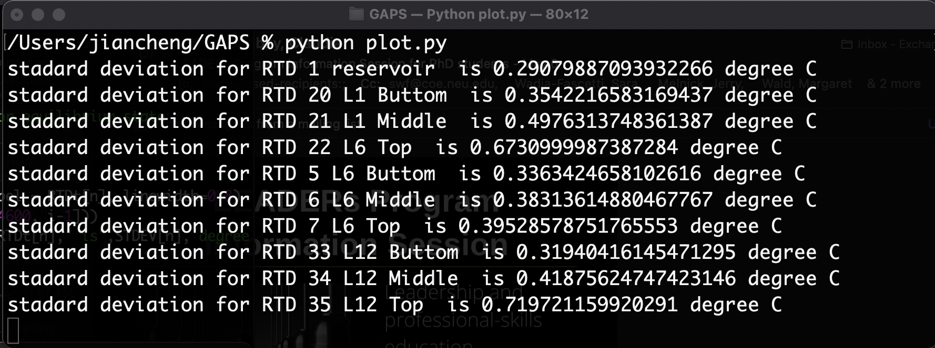
Stable state fluctuation

Slide 6
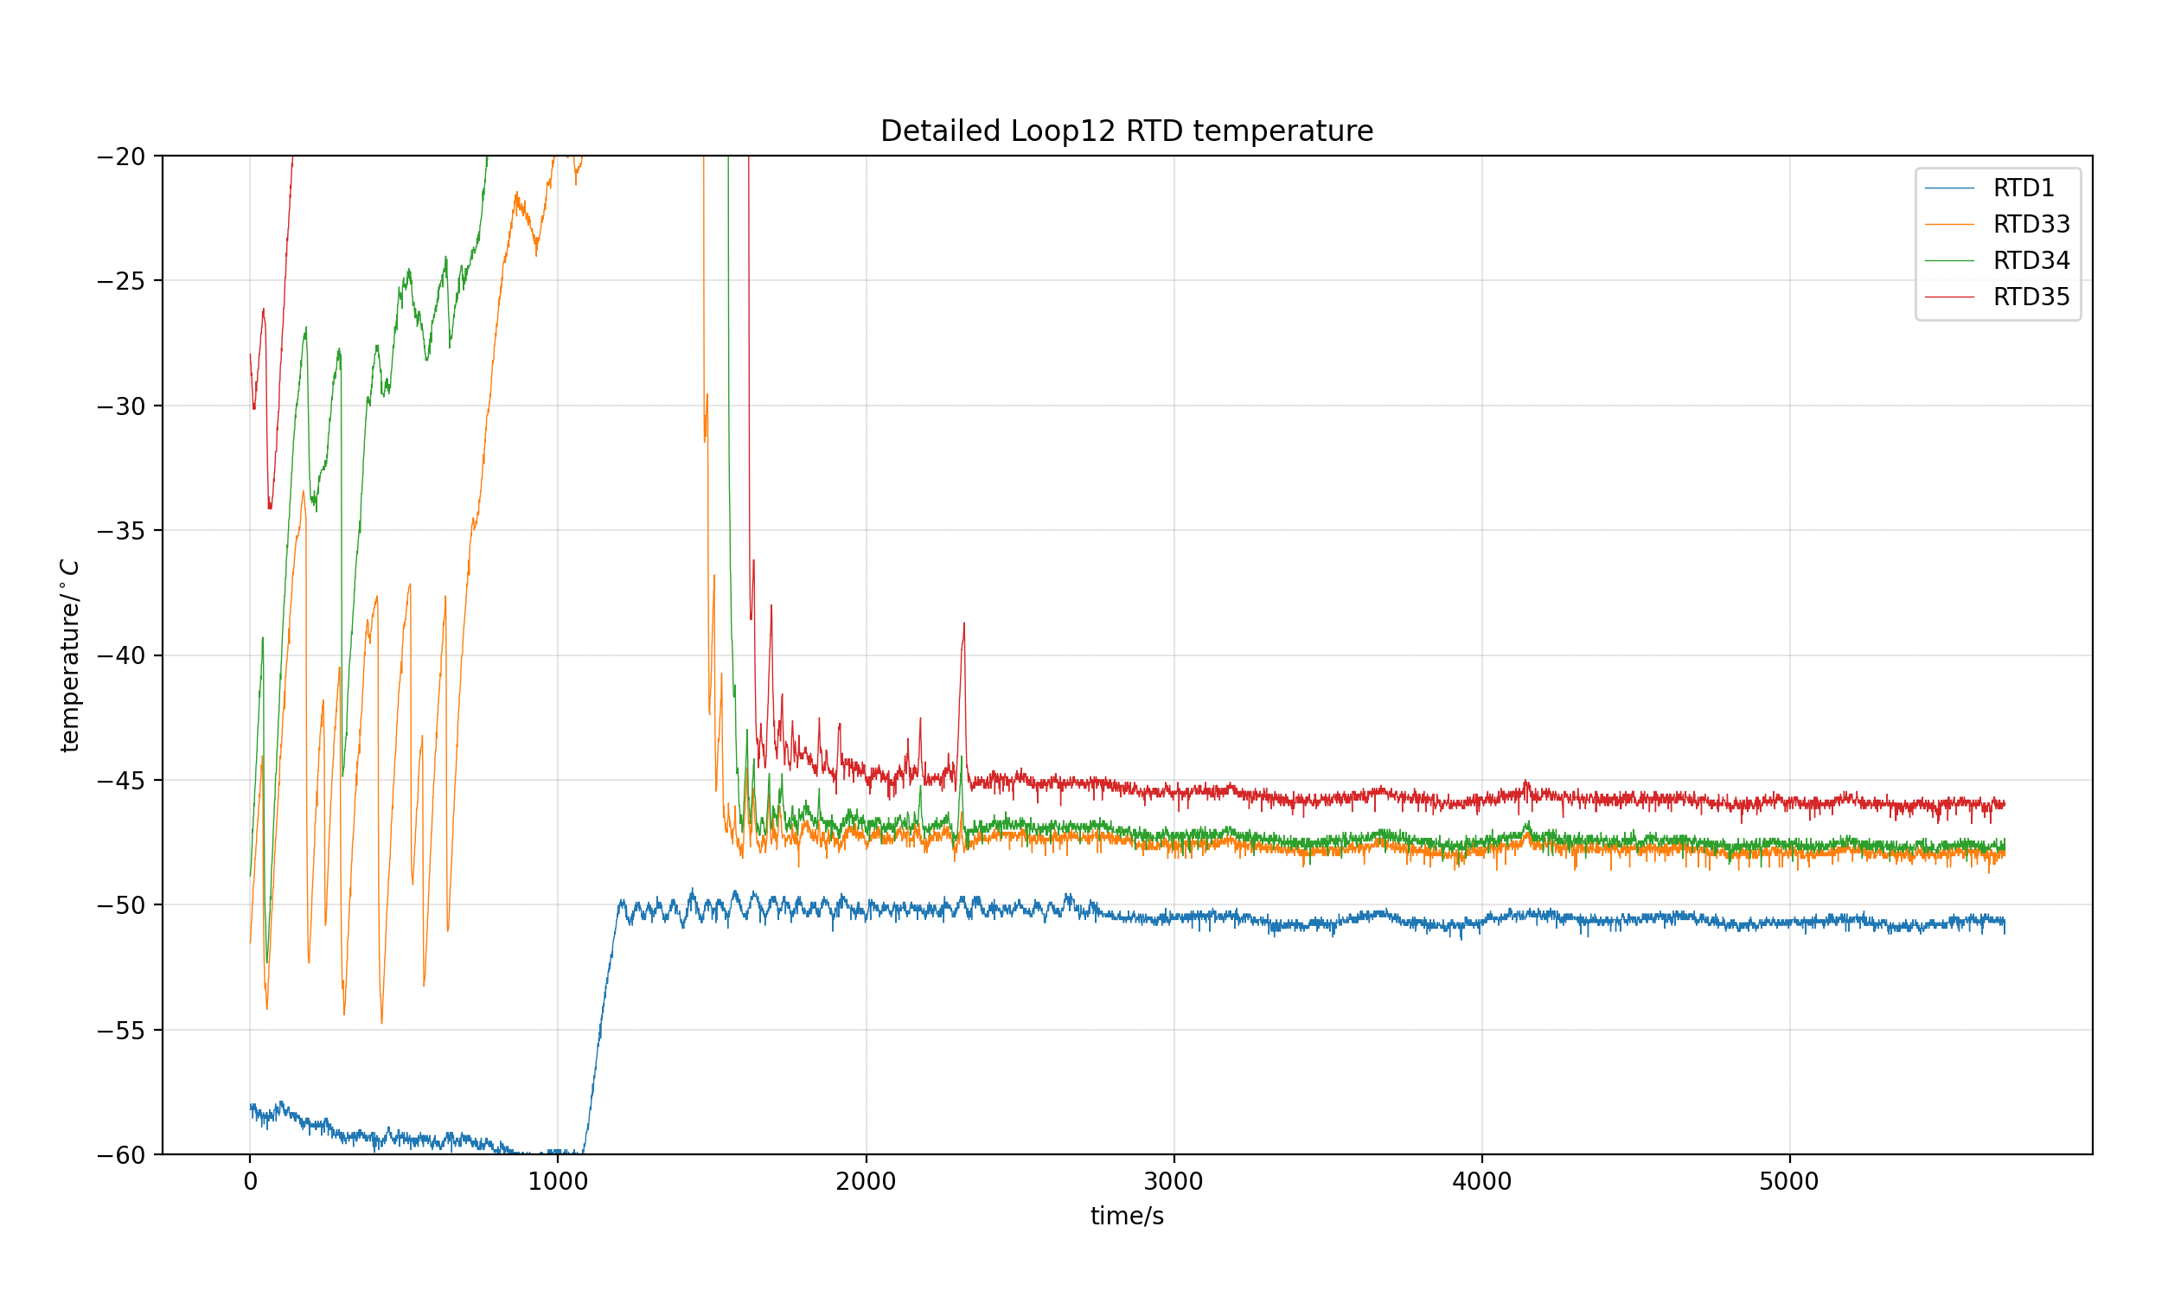
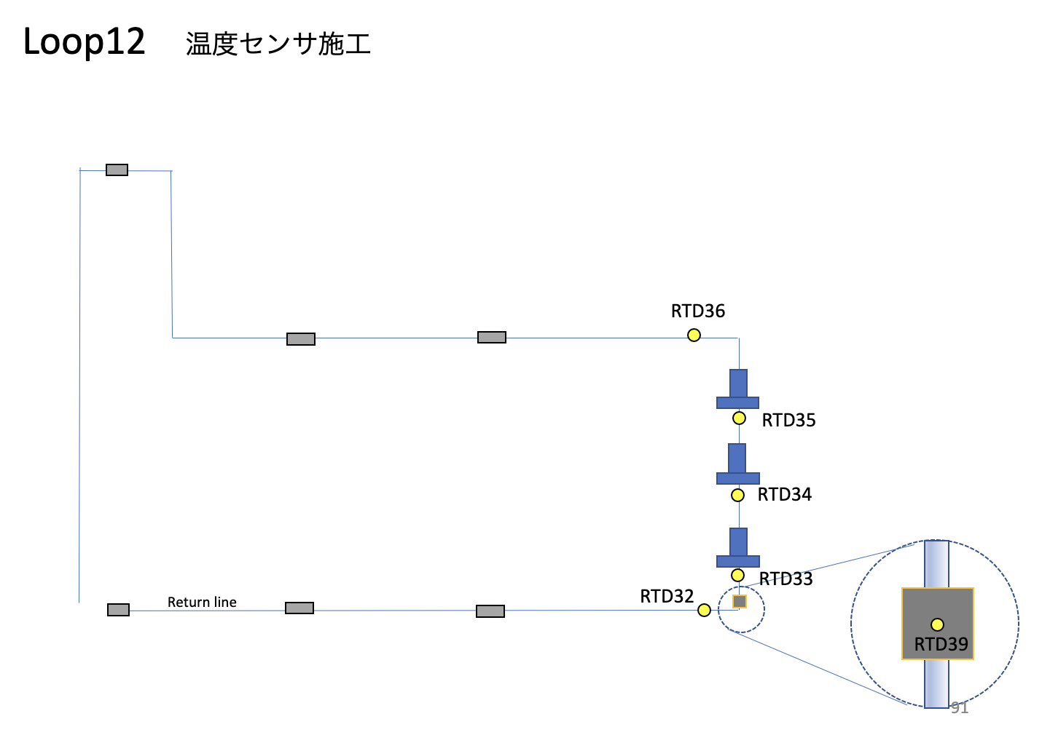
Detectors for each loop
Loop figure From JAXA

Slide 7
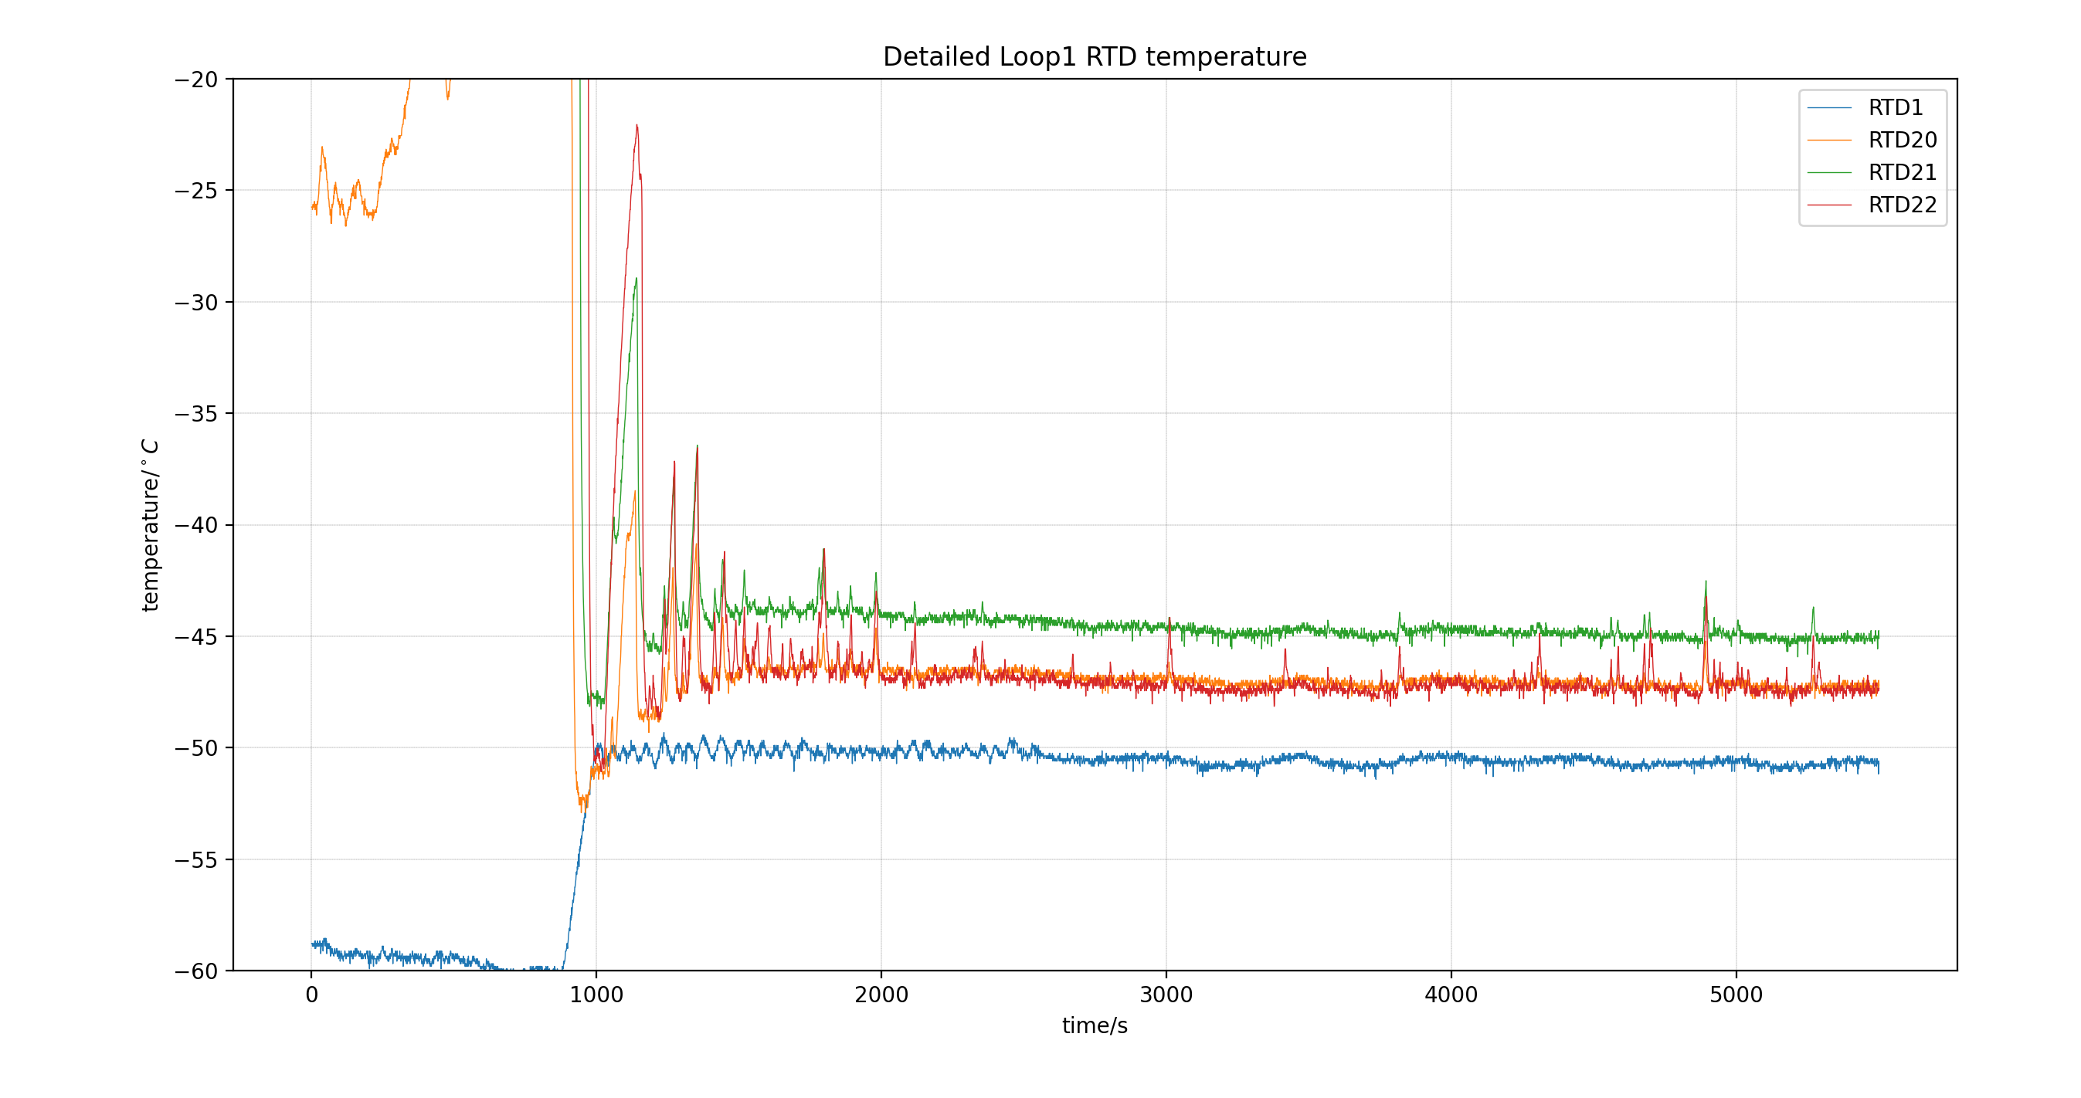
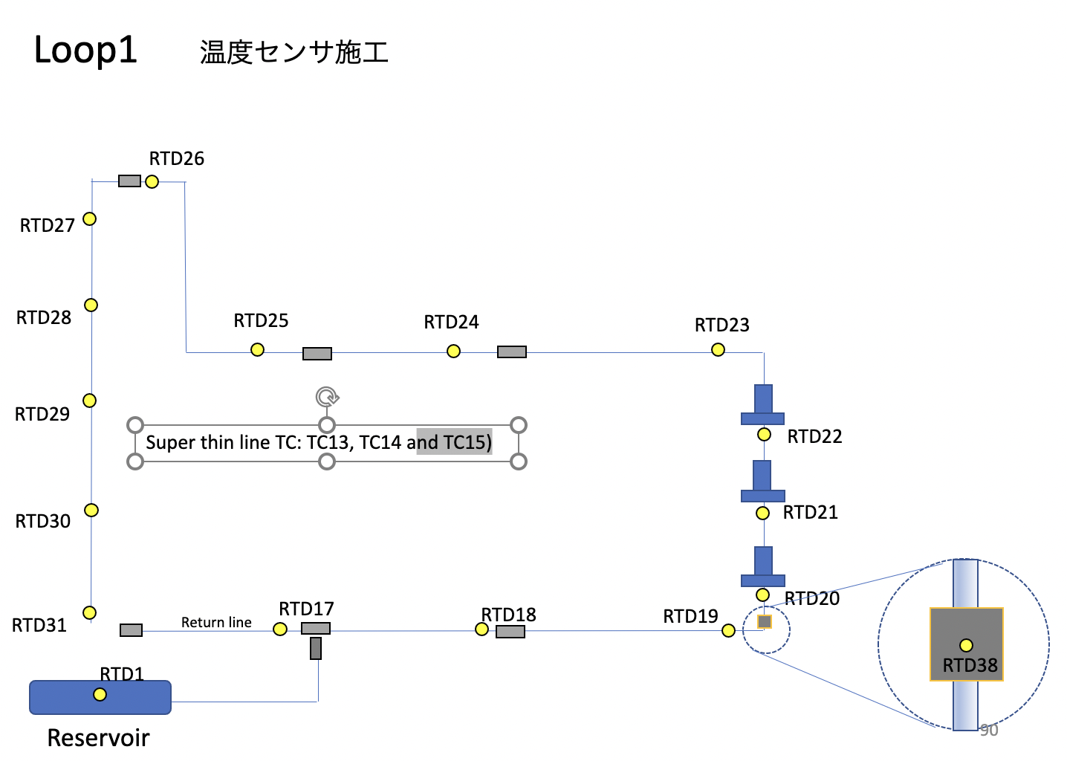
Detectors for each loop
Loop figure From JAXA

Slide 8
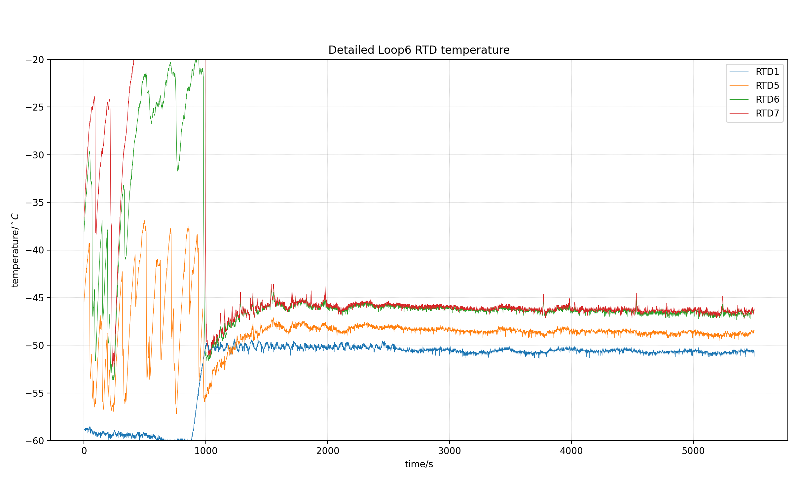
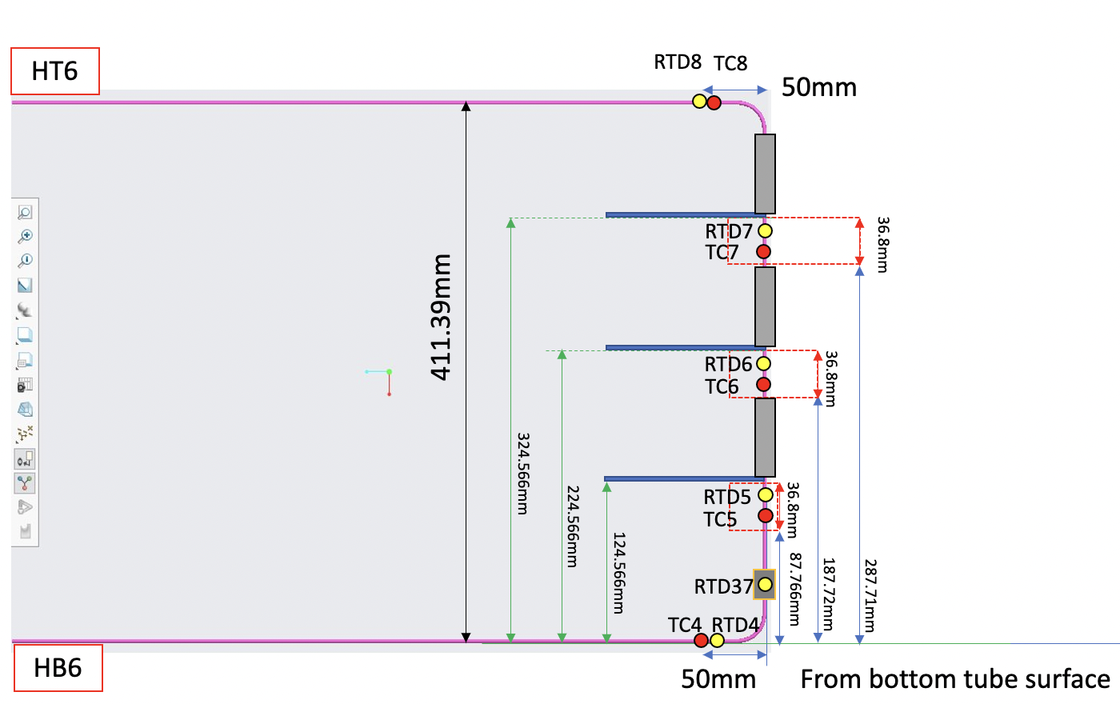
Detectors for each loop
Loop figure From JAXA

Slide 9
Future plans and questions
Rise up the temperature and the power of the dummy heater to creat the same condition that JAXA did the test. Then compare the exact result.
Connect RTD40 which is the sensor for room temperature. Also collect TC data for analysis(to do this we have to remove all the insulator layers).
We can remote control reservoir heater and recording data through teamviewer, but so far don’t have a way to control the chiller and dummy heater
Help Mengjiao with Detector module test, might need some adjustment if the noise showed to be too large during detector test.

Slide 10
Thank you

